Slide 1
MANAGING COARSE REJECTS FROM COMPOST PLANTS and ORGANICS FROM BIOMINING
Almitra H Patel
Member, Supreme Court Committee
for Solid Waste Management
in Class 1 Cities
almitrapatel@rediffmail.com
www.almitrapatel.com
1

Slide 2
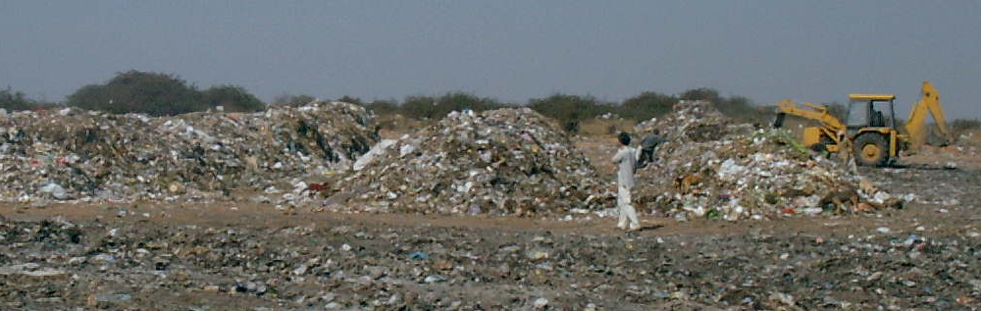
Stabilising organic waste is the first step in compost production. Waste is unloaded in long daily heaps for weekly turning four times. Giving air to all waste stops leachate and methane.

Slide 3
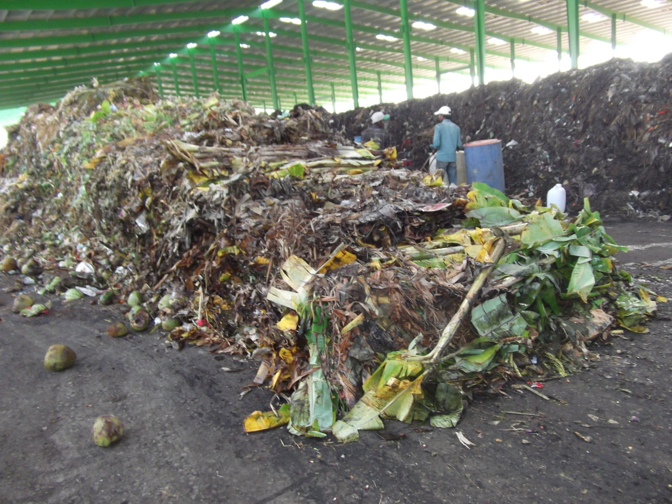
Every 100 tons of raw organic waste yields around 15% fine compost meeting FCO standards

Slide 4
The Stabilised waste is then sieved
It is usually sieved through 4 screens: 100 mesh,
~ 35 meshand rejected , 14 mesh and 4 mesh.
Only ~ 15% is finer than the 4mm specified in FCO
Stds (Fertiliser Control Order) for sale as compost.
~ 40% weight is lost as water vapour because the waste moisture goes down from 60% to 20%.
So as much as 45% by weight of raw Wet Waste is left over as coarser fractions, currently unsold.

Slide 5
What happens to coarser fractions
The 4 to 14 mesh fraction is usefully used to cover fresh wind-row heaps for smell control and to encircle the heaps to absorb leachate.
The two coarser fractions, of 100 to 35 mesh and 35 to 14 mesh are currently discarded.
They are wrongly called ‘RDF’ but are too wet for
use as co-processing fuel with coal in cement kilns.
So they are sent to landfills where they decompose slowly, releasing leachate and methane.

Slide 6
The slow decomposition is useful
It can be as useful as fine compost, adding
humus and useful microbes to soil, but
releasing nutrients slowly.
City compost has been found very useful for reclaiming badly degraded soils, often ruined by over-irrigation which brings up salt to the surface, leaving a white crust, making the field totally infertile over time.

Slide 7
Reclaiming Saline-Alkaline (Sodic) soils
In 2001 -2002, 25 farmers each saw one hectare of their
totally unproductive soils near Sangli (Mah) restored to
80% fertility in 18 months with the help of city compost.
In June 2001 kharif (monsoon) season, the degraded land
was deep-ploughed by tractor and broadcast with 4 tons /
hectare of Celrich brand city compost +s 1 t/ha of gypsum.
Sesbania (dhaincha) was sown as a green manure crop and ploughed in after 55 days of growth.
In the 2001 rabi (winter) season, 3 t/ha of Celrich were added, then sown with mustard, wheat or table beet. All gave ~60% of normal good growth.
In 2002 kharif, again after 4 t/ha city compost plus 1 t/ha gypsum, soybean gave 80% of normal growth.

Slide 8
Potential Solution
Coarser organic fractions can easily break down
over time in the soil and add good humus and
porosity as well as essential microbes to improve
soils and plant growth, just as fine compost does.
They can be mixed with soil and usefully added into tree pits for horticulture (mango, guava, grape etc) or for agro-forestry or forestry.
Ploughed into crop fields, it can make the soil porous and water-holding, promoting strong root systems for healthy and productive plants

Slide 9
Proposed Trials near Bangalore
Karnataka’s Director CADA, Command Area Development Authority, has agreed in principle to conduct demonstration field trials in the Cauvery irrigation basin soils suffering salinity.
Rejects from the Mysore or Bangalore compost plants will be tried in Maddur Taluk.
For this, both existing and new compost plants will have to organize the transport of their coarse rejects to trial field plots identified by CADA . At whose cost?

Slide 10
Biomining of Old Waste Dumps
Biomining of old open dumps of waste is a method of reclaiming both materials and space.
Bio-mining for land reclamation and cleanup has been completed at a dozen locations around India since 1998, and is currently being done at Raichur and Kumbakonam.
One-third of the sieved material is a mixture of fine organics and soil called bio-earth. Raichur farmers are buying this for soil improvement at Rs 2500 per ton, and Rs 1000 per ton at Kumbakonam, for improving their soil vitality.

Slide 11
CONCLUSION
In a country starved of organic manures with livestock populations declining, there is a tremendous opportunity to make up the shortage not just with compost but with all of the organic fractions arising from old and new city waste.

